Slide 1


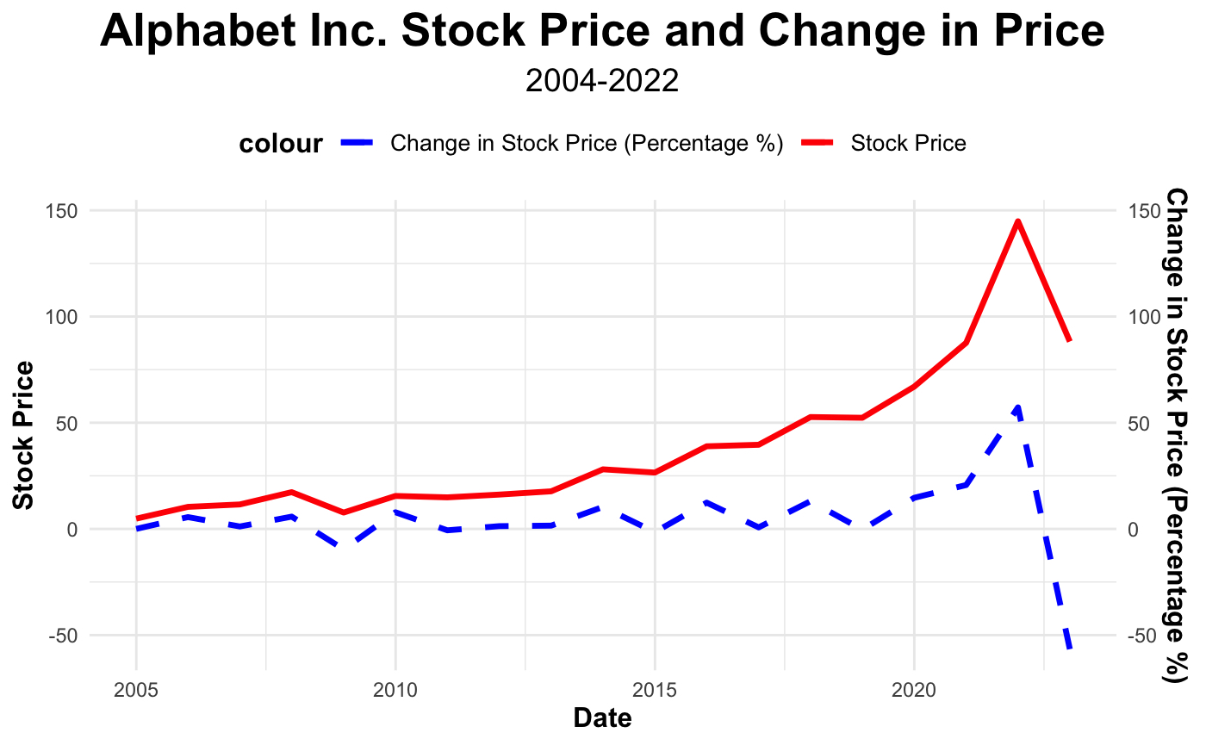
Predicting Alphabet Inc. Stock Price Dynamics: A Linear Regression Approach to Financial Forecasting
Christian B. DeJong
Introduction
Per the Corporate Finance Institute, price target predictions for publicly traded companies have historically achieved an accuracy rate of approximately 30%. These price targets aim to estimate the value of a specific security at a future point in time. Analysts employ various financial indicators and assumptions to make these predictions, yet many of these calculations are inconsistent.
Discrepancies in financial forecasting often arise from several factors. Firstly, analysts may have access to different data sources and employ varying analytical techniques, leading to diverse outcomes. Furthermore, the subjective interpretations of available information can create biased forecasts.
In addition to these discrepancies, creating financial forecasts can be time-consuming, particularly when analyzing multiple companies. This time-consuming nature of the forecasting process highlights the need for developing a more efficient model. By creating a streamlined model for predicting stock prices, analysts can save valuable time and resources and establish greater consistency in their predictions.
Discussion
MktReturn = 56.7027. This means that for every one percentage point increase in the market return, the average change in price is expected to increase by 56.7027 dollars.
OCF = 0.0056575. Meaning that for every $1,000 increase in OCF, the average change in price is expected to increase by 0.0056575 dollars.
Revenue = -0.0019362. Meaning that for every $1,000 increase in Revenue, the average change in price is expected to decrease by 0.0019362 dollars.
InflationRate = 0.4686980. Meaning that for every one percentage point increase in the Inflation Rate, the average change in price is expected to increase by 0.4686980 dollars.
EmployRate = -1.4632252. Meaning that for every one percentage point increase in the Unemployment Rate, the average change in price is expected to decrease by 1.4632252 dollars.
R-Squared = 0.679 indicates that the model explains ~67.9% of the variation in the change in price.
Predictions
Using GOOGL’s 2023 Quarter 1 Financial reports, we can use this model to predict GOOGL’s end of year change in stock price.
December 31, 2023 = -19.8418
Analysis and Results
Chng_in_price = MktReturn + Revenue + OCF + EmployRate + InflationRate
Data
Our model incorporates financial data for Alphabet Inc. from 2004 to 2022, which is publicly accessible due to its status as a publicly traded company and the associated SEC regulations. The variables included in the model are:
Market Return Measure: We utilized the S&P 500 index as a benchmark to gauge overall market performance, as it is commonly considered a standard for comparing market-wide trends.
Revenue and Operating Cash Flows: These variables indicate a company's performance during a specific period. A company with high revenue and operating cash flows typically demonstrates strong performance.
Inflation Rate: The inflation rate is included in the model as a general measure of a company's financial stability. There is a correlation between inflation rates and FED rate hikes, which can influence a company's financing activities.
Unemployment Rate: This variable reflects the overall growth or contraction of the economy, providing insight into the broader economic context in which the company operates.
Variable | Estimate | Std. Error | t value | P-value
Intercept | 3.5155900 | 14.5639840 | 0.241 | 0.81302
MktReturn | 56.7027684 | 20.0017307 | 2.835 | 0.01406
Revenue | -0.0019362 | 0.0005805 | -3.335 | 0.00537
OCF | 0.0056575 | 0.0016886 | 3.350 | 0.00522
EmployRate | -1.4632252 | 1.9210611 | -0.762 | 0.45985
InflationRate | 0.4686980 | 2.1863572 | 0.214 | 0.83358
References
“LTM (Last Twelve Months).” Corporate Finance Institute, 20 Dec. 2022, https://corporatefinanceinstitute.com/resources/valuation/last-twelve-months-ltm/.
“Alphabet - Stock Price History: GOOGL.” Macrotrends, https://www.macrotrends.net/stocks/charts/GOOGL/alphabet/stock-price-history.
“Current US Inflation Rates: 2000-2023.” US Inflation Calculator | Easily Calculate How the Buying Power of the U.S. Dollar Has Changed from 1913 to 2023. Get Inflation Rates and U.S. Inflation News., 4 Apr. 2023, https://www.usinflationcalculator.com/inflation/current-inflation-rates/.
“Alphabet Inc. 10K Form.” Goog-20211231, https://www.sec.gov/Archives/edgar/data/1652044/000165204422000019/goog-20211231.htm.
“Charts Related to the Latest ‘The Employment Situation’ News Release | More Chart Packages.” U.S. Bureau of Labor Statistics, U.S. Bureau of Labor Statistics, https://www.bls.gov/charts/employment-situation/civilian-unemployment-rate.htm.
“S&P 500 Index - 90 Year Historical Chart.” MacroTrends, https://www.macrotrends.net/2324/sp-500-historical-chart-data.
Multiple R-squared: 0.679, Adjusted R-squared: 0.5555

